Slide 1
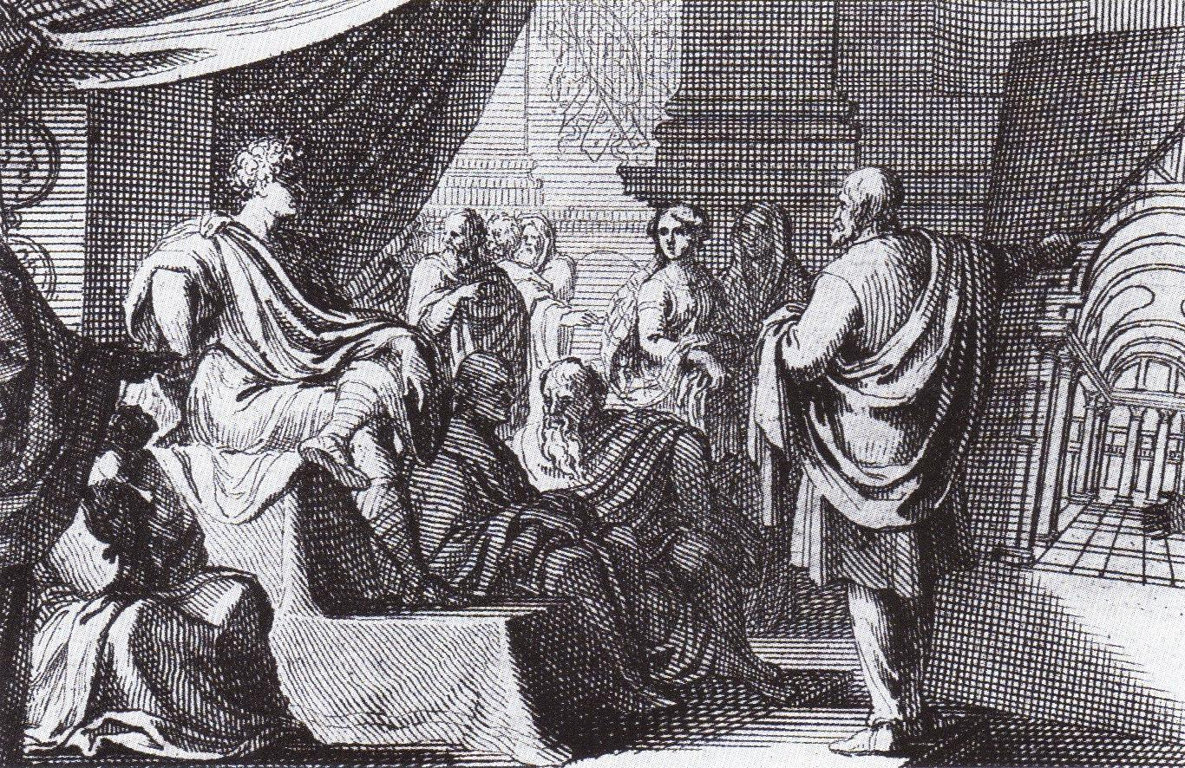
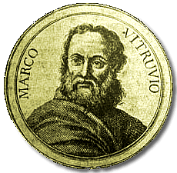
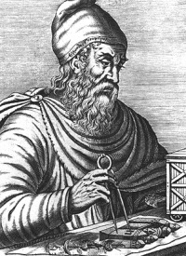
VITRUVIUS

Slide 2
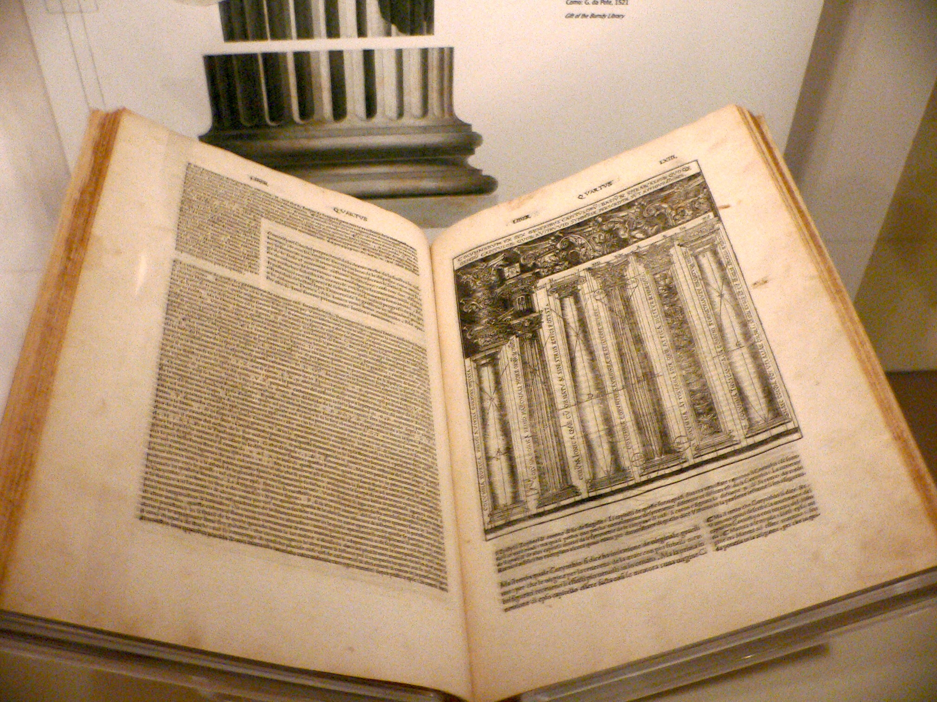
Who was He?
Born: 85 BC
Died: 20 BC
Marcus Vitruvius Pollio is known almost exclusively through his famous ten volume work On Architecture. Even his name is in doubt with only Vitruvius being certain. Other than what can be deduced from that work, little is known about his life although he is mentioned in works by Pliny the Elder and Frontinus. Two different towns have been proposed by historians as his birthplace. We have suggested Fundi (now Fondi), which is about midway between Rome and Naples. However the other suggestion is Verona which is in the north of Italy, roughly west of Venice.
It is clear that he must have been born into a prominent Roman family.

Slide 3
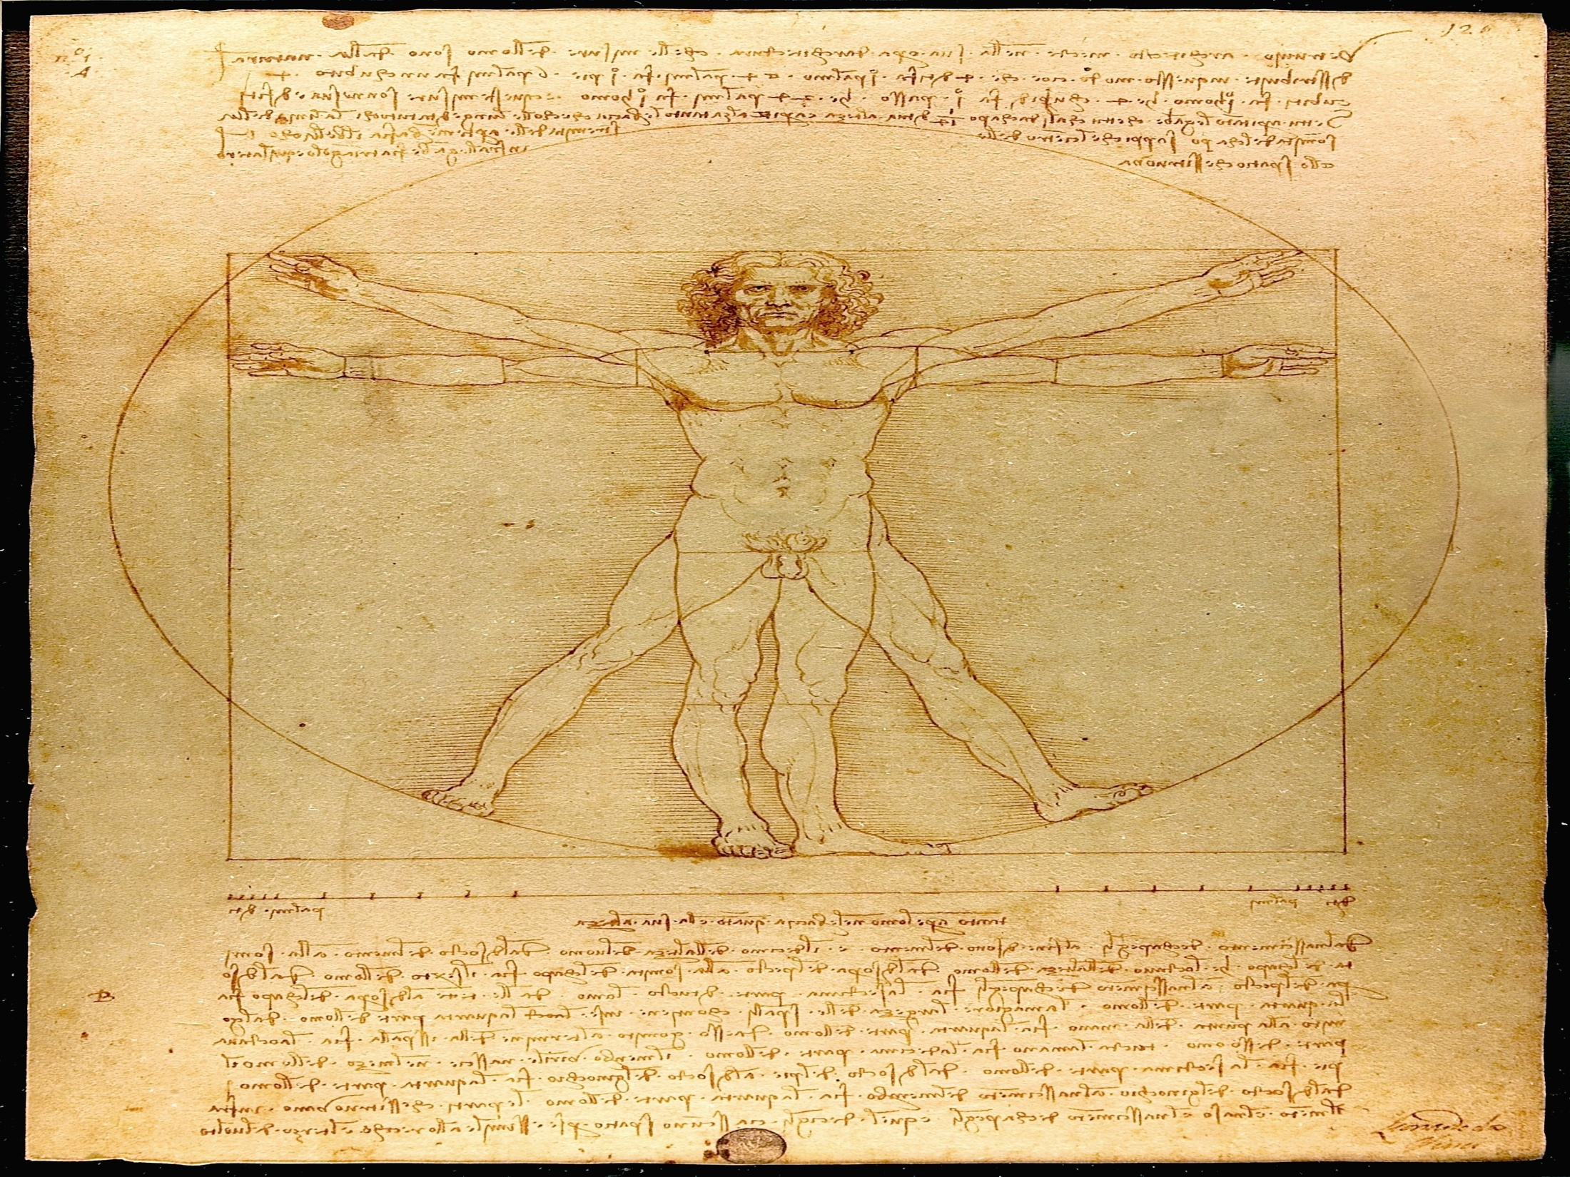
He trained in architecture and served with the engineering corps in Caesar's army. He travelled widely with the army and we know he served in Gaul, for example he was in the fortress of Larignum in 56 BC and in Marseilles in 48 BC. He was also in Zama in North Africa in 46 BC, the site of the Battle of Zana in 202 BC in which the Romans defeated Hannibal to end the Second Punic War. The Romans were building a city there in Vitruvius's time. After Caesar was assassinated in 44 BC, Vitruvius joined the army of Octavian (later the Emperor Augustus), as a military engineer. By 33 BC we know that he was involved in the construction of aqueducts. His most famous (and only known) work is the ten volumes of On Architecture which we know was written near the end of Vitruvius's life.

Slide 4
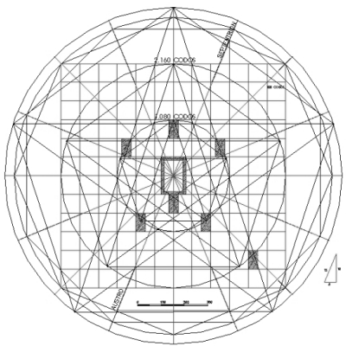
Analysis of His works
The first comment to make about his masterpiece is that it is a little difficult to tell how close to the original is the book which has come down to us today. It is clear that the work has been regarded as an architect's manual from the time it was written up to the middle ages, so has been improved over the years as one does with a manual. The second comment must be that, for Vitruvius, architecture had a much wider scope than we would consider today. For example water clocks, sundials and pumps are all described by Vitruvius, topics which would hardly be considered to be part of the study of architecture today. Next we note Vitruvius's interest in history - this means that we are treated to information about earlier works and scientists which would otherwise have been lost.

Slide 5
Vitruvius believes that the architect needs to have studied many disciplines:-
“ Let him be educated, skilful with the pencil, instructed in geometry, know much history, have followed the philosophers with attention, understand music, have some knowledge of medicine, know the opinions of the jurists, and be on with astronomy and the theory of the heavens.”
Accordingly, Vitruvius proceeded with a lengthy homily on education.

Slide 6
The architect should not only be skilled in drawing, but also have a working grasp of arrange of subjects:
Geometry( since this bears on planning and optics)
History(so as to explain the origin of architectural forms)
Philosophy(for moral education )
Music(it has practical application for adjusting the tension of catapults as well as in acoustics.)
Medicine(to access the healthiness of sites and source water)
Law(to advice party wall agreements and contracts)
Astronomy(so as to grasp the principles of sundial design and locate north, south,east and west.

Slide 7
Mathematics plays an important role for Vitruvius:-
“Geometry is of much assistance in architecture, and in particular it teaches us the use of the rule and compasses, by which especially we acquire readiness in making plans for buildings in their grounds, and rightly apply the square, the level, and the plummet. By means of optics, again, the light in buildings can be drawn from fixed quarters of the sky. It is true that it is by arithmetic that the cost of buildings are calculated and measurements are computed, but difficult questions involving symmetry are solved by means of geometrical theories and methods.”

Slide 8
DE ARCHITECTURA CONTENTS:
BOOK I
Dedication to the Emperor; branches of knowledge that an architect must be acquainted with; the factors involved in siting a town and designing its walls, including a rather odd extended explanation of the various winds.
BOOK II
A story about Dinocrates, architect to Alexander the Great, serves as prologue. Second prologue, on the origins of architecture; but most of the book is aboutmaterials: bricks, sand, lime, pozzolan concrete; kinds of stone and types of stone masonry; timber.
BOOK III
Some comments on the chance nature of fame in the arts serve as a rather irrelevant prologue: it seems clear Vitruvius felt he had to have one. The book then proceeds to temples, setting forth some basic definitions, then describing a canon for the construction of temples of the Ionic order.
BOOK IV
Corinthian and Doric temples; temple doors and altars; the Tuscan order, which Vitruvius seems to find primitive.
BOOK V
In which the author warns you that architecture is highly technical, then proves it in spades in his exposition of civil public spaces: the forum, the basilica, the theatre and its porticos, the palaestra and the baths; harbors. Vitruvius takes particular delight in the acoustics of the theatre about which he seems to know much, much more than he has allowed himself to tell us for fear of boring us: it's a pity.

Slide 9
BOOK VI
Prologue: poor but honest makes a good architect. A second sort of prologue on the diversity of mankind from climate to climate, easing into the topic of private houses: their construction should depend on the climate as well. Layout of the Roman house and the Greek house; considerations of weather, the function of the rooms, the owner's social position.
BOOK VII
Long prologue on the importance of sharing knowledge, and, conversely, not plagiarizing. True to his word, Vitruvius then shares with us his recipes for interior decoration: the preparation and execution of wall paintings: lime, stucco, plaster, pigments.
BOOK VIII
Water: how to find it, where it comes from, types of water, how to judge its quality; how to transport it (aqueducts). A disappointing book though, since most of it is given over to anecdotal material, cribbed from other authors, about the effects of waters from various sources.
BOOK IX
Prologue: architects deserve more honor than wrestlers. Useful technical achievements of architects: a method of doubling a square, a method of constructing a right triangle, Archimedes and the crown. Sundials and water-clocks, preceded by a long section on the planets and the constellations.
BOOK X
Prologue: a proposal on how to deal with cost overruns. The book then details many kinds of machines used in civil and military engineering: pulley-based machines for lifting and transporting weights; the principle of the lever; machines that convert rotary to linear motion and vice-versa, including the water-screw. The hydraulic organ. An odometer of sorts. Siege machines: catapults, scorpions, balistae, tortoises and how to defend against them.

Slide 10
Analysis of Character
What we felt was that Vitruvius was humble and had lot of common sense. As a part of being in a war, he didn’t want to create conflicts with his works. In the preface of book I, he says:
“While your divine intelligence and will, Imperator Casear were engaged in acquiring the right to command the world and while your fellow citizens, when all their enemies had been laid low by your invincible valour, were glorying in your triumph and victory, --- While all foreign nations were in subjection awaiting your beck and call, and the Roman people and senate, released from their alarm, were beginning to be guided by your most noble conceptions and policies, I hardly dared, in view of your serious employments to publish my writings and long considered ideas on architecture, for fear of subjecting myself to your displeasure by an unseasonal disruption.
But when I saw that you were giving your attention not only to the welfare of society in general and to the establishment of public order, but also to the providing of public buildings have been enriched with provinces by your means, but for utilitarian purposes, so that not only should the State have been enriched with provinces by your means, but that the greatness of its power might likewise be attended with distinguished authority in its public buildings, I thought that I ought to take the first opportunity to lay before you my writings on this theme…”

Slide 11
He admits that he may not be perfect in spite of knowing all the qualities that he has laid down that an architect has to have.
“… I request, Caesar, both of you and those who made read the said books, that if anything is set forth with too little regard for grammatical rule, it may be pardoned. For it is not as a very great philosopher, nor as an eloquent rhetorician, nor as a grammarian trained in the highest priniciples of his art, that I have striven to write this work, but as an architect who has had only a dip into those studies. Still as regards the efficacy of the art and the theories of it, I promise and expect that in these volumes I shall undoubtedly show myself of very considerable importance not only to builders but also to all scholars..”
His outlook is fundamentally Hellenistic.

Slide 12
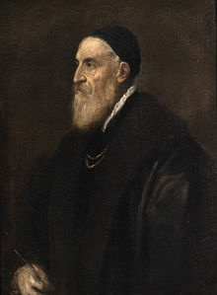

Slide 13
Symmetria
Vitruvius defines symmetria as a proper agreement between the members of work itself and relation of the parts and the whole general scheme, in accordance with a certain part selected as standard.
The best key to fuller understanding of the concept is the beginning of Book III where he explores an analogy with human body.
“The design of a temple depends on SYMMETRIA, the principles of which must be more carefully observed by the architect…. Without symmetria and proportion, there can be no principles of design of any temple; that is ,if there is no precise relation between its members ,as in the case of a well shaped man.”

Slide 14
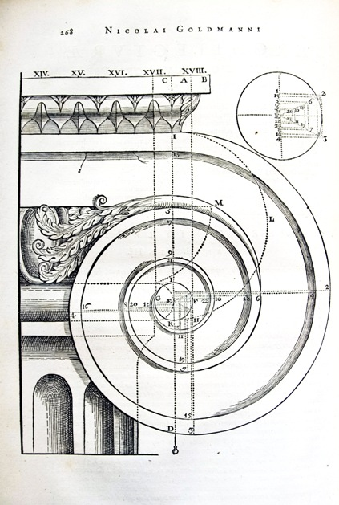

Slide 15
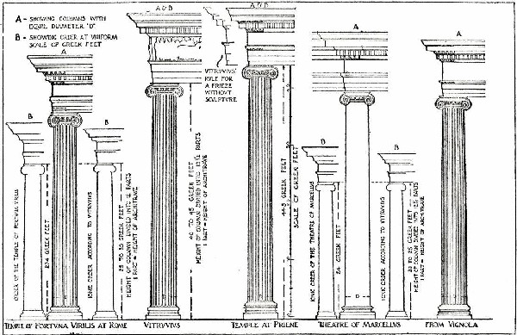

Slide 16
Vitruvius lists a series of ratios:
Face and from wrist to fingertip- takes 1/10th of total height and head takes 1/8th of height and so on..
Vitruvius also tells that when a man is laid flat on his back, with extended hands and feet, he may be inscribed in a circle with his hands and feet touching its circumference.
Units of measurements were derived from the members of the body; the finger(digitus), palm(palmus), foot(pes), and cubit(cubitus- the length of the forearm).
Further, he says that Greek mathematicians and philosophers took the body as a source of number theory, investigating 6 and 10 with special significance because the body is 6ft tall and owns 10 fingers and toes.

Slide 17
Principal Dimensions of Vitruvian Man | a | b | c | d | H
Face height; hand length | 1 | 4/5 | 3/5 | 2/5 | 1/10
Head Height |  | 1 | 3/4 | 1/2 | 1/8
Foot length |  |  | 1 | 2/3 | 1/6
Chest height |  |  |  | 1 | 1/4
Total height; Arm Span |  |  |  |  | 1

Slide 18
Thus, symmetria is the mathematical harmony that comes of commensurable numbers entering into a form via distinct modes, principally ratio, shape, dimension and there petition of like elements. In Vitruvius’ principle of MODULAR COMPOSITION. A small physical element, a modulus or embater, typically the lower diameter of a column shaft or the width of a triglyph, was multiplied, to goern the most significant limits of a colonnade or building. This guaranteed mathematical harmony in terms of dimension, ratio and repetition.
For Vitruvius, task of the architect was to imitate Nature, not literally, but rather by analogy.His human proportions idealized the canons of sculptors like Polykleitos.The point was that its symmetria reflected a cosmic order that reduced ultimately to whole numbers.

Slide 19
SIX PRINCIPLES OF DESIGN:
Six fundamental principles are ;ordinatio, disposition ,eurythmia, symmetria, décor and distributio. Their origins emerge clearly enough since he supplied Greek equivalents for three.
On this basis ancient and modern equivalents might be set out as follows;
Greek | Latin | English
taxis | ordinatio | order
diathesin | dispositio | arrangement
eurythmia | ---- | proportion
symmetria | ---- | symmetry
prepon | decor | propriety
oikonomia | distributio | economy

Slide 20
Theories Of Beauty
Vitruvius believed that an architect should focus on three central themes when preparing a design for a building: firmitas (strength),utilitas (functionality), and venustas (beauty).
So it followed, according to Vitruvius, that an architect's designs must refer to the unquestionable perfection of the body's symmetry and proportions. If a building is to create a sense of eurythmia - a graceful and agreeable atmosphere - it is essential that it mirrors these natural laws of harmony and beauty.

Slide 21
In the end
We felt Vitruvius was a honourable man filled with common sense and knowledge. We felt that he observed details a lot. In spite of knowing less about him, We felt that he led an eventful life. He was a man who was proud of his history. In the end he made an impact on the world. Even his presence is seen now in most architectural elements.
We are lucky that we choose him as our topic. After all he is truly a father of architecture.

Slide 22
Thank you
By
Sushimita N
Debaprana Sarkar

